Slide 1
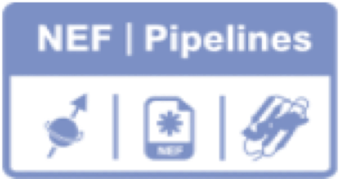


NEF-Pipelines 0.1.20beta
How To
Export Data to MARS and PINE for Auto assignment using NEF-Pipelines

Slide 2
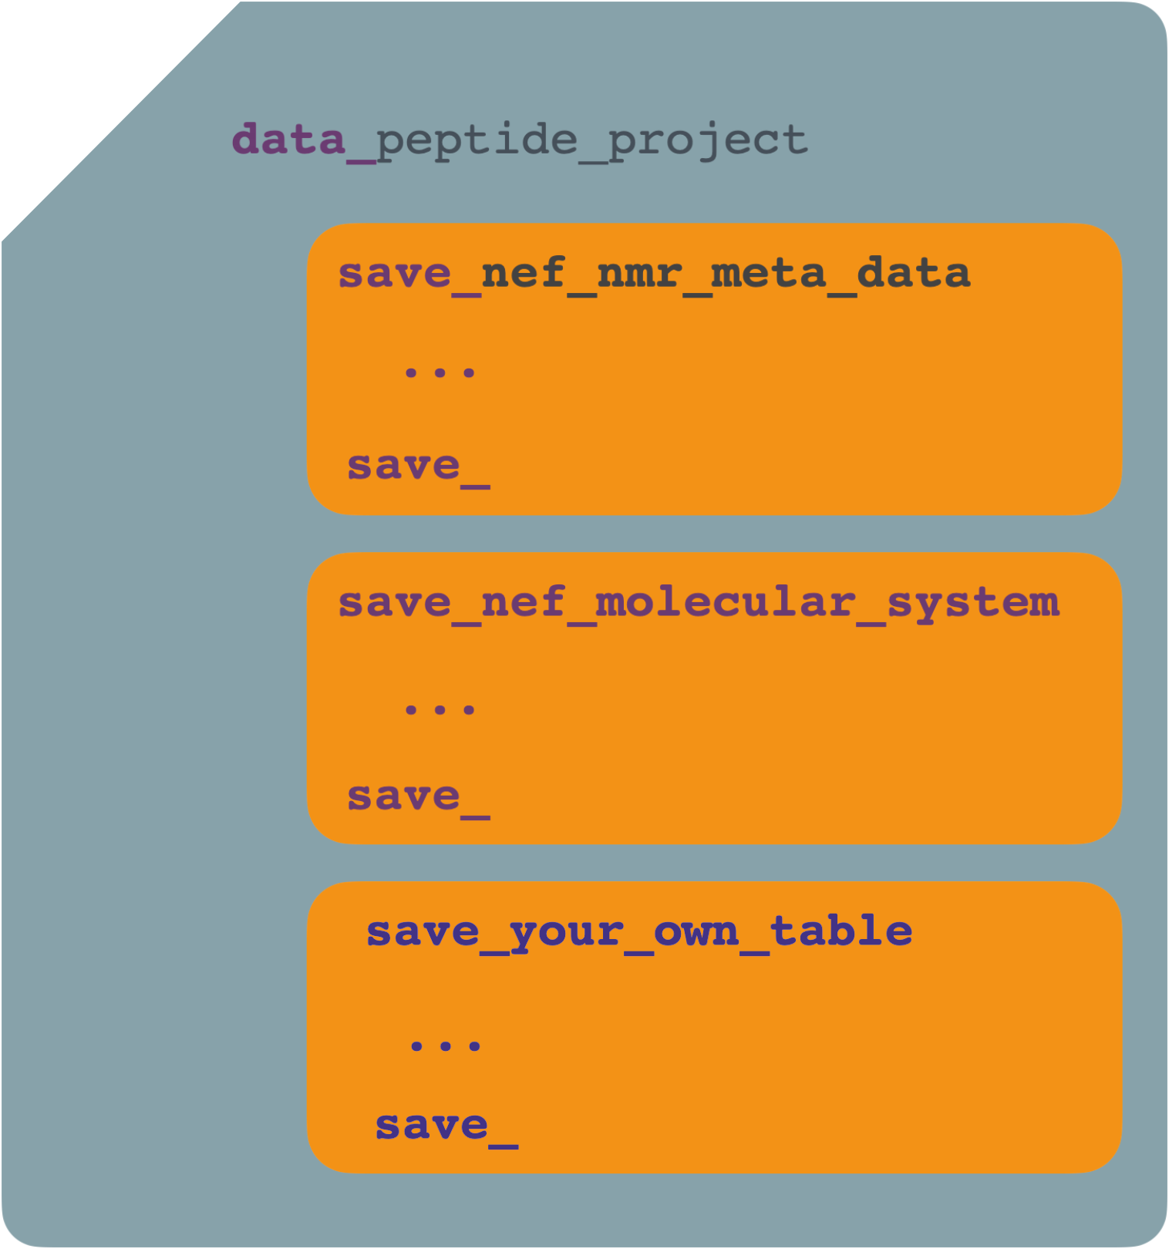
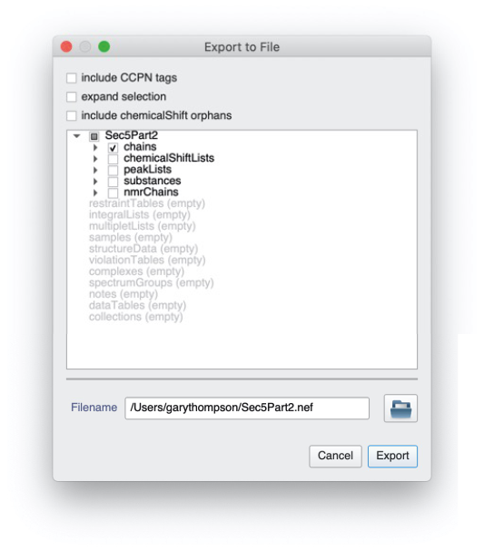
Introduction
This How To will show you how to use NEF-Pipelines, a set of tools for manipulating NEF (NMR Exchange Format) files. NEF files are text files used for transporting files between programs used for NMR data analysis. NEF has been developed by a consortium of NMR software developers including CCPN. It is not a CCPN project, it is a community project.
What’s inside a NEF File?
A NEF file is a text file, and specifically a STAR file so it has the same basic syntax as a NMRStar file or a mmCIF/PDBx file. However, it has a different and more simple structure designed for interchanging NMR data, at the most basic it’s a series of tables with extra information. Here is the schematic of a NEF file… This file has a entry name peptide_project
and three containers for tables of data which are called saveframes in the parlance of a STAR file. They are called nef_nmr_meta_data, nef_molecular_system and your_own_table. The first two are defined by the NEF standard and hold information about the particular file (meta data), the definition of the molecules in the file molecular system and a custom frame your_own_data_table (there are ways to save your own data in a NEF file and not clash with with the built in data).
Let's create our first NEF file and have a look at what’s in it. To do this we will open the tutorial project Sec5bPart2.ccpn in CcpNmr Analysis and go to File → Export NEF. This will show the following dialog. We are only going to export the chains in the project and not include CCPN tags (extra data CCPN saves into NEF files using its own extensions). Save it to a file name of your choice with the extension .nef
To look inside the file we need to find a text editor on you computer. We will use the following ones:
Windows: notepad,
Linux: kate / gedit
MacOS textedit
Use the File → Open menus
Why does my OS think it’s a photo?
Unfortunately NEF can also stand for Nikon Exchange Format a format used by cameras…

Slide 3
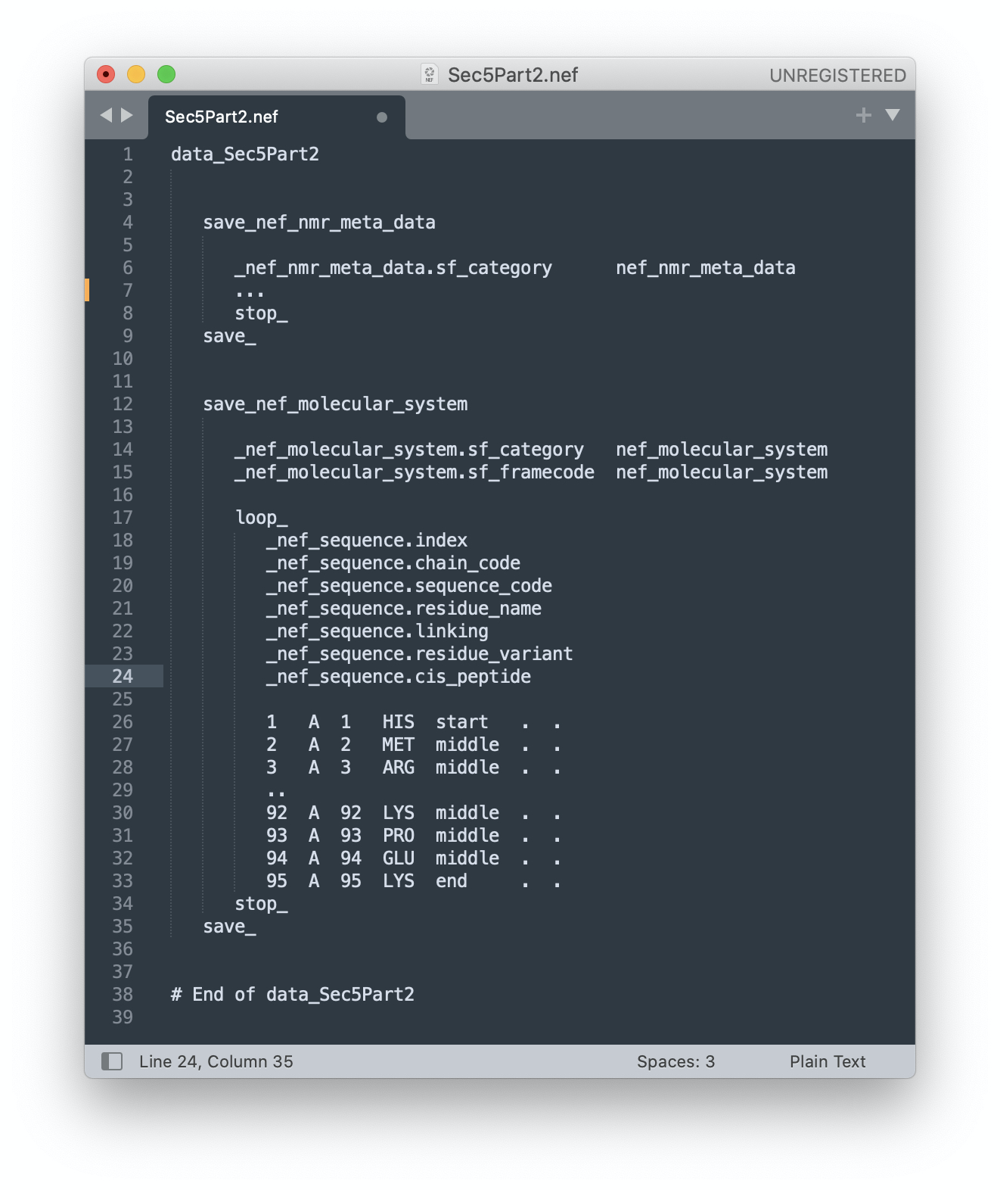
You should then find you have a text file that looks somewhat like the following:
There will be more text we have hidden which we have replaced with … to make it fit here. Lets look at the second save frame. This has some meta data which is required sf_category and sf_framecode and then a loop which is our table of data. In this case it has six columns index, chain_code, sequence_code, residue_name, linking, residue_variant, and cis_peptide. These define a chain of residues in a molecule with chain A starting at HIS 1 and ending at LYS 95. Note the table or loop starts with loop_ and ends with stop_. The saveframe (which can contain multiple loops) ends with a save_. The entry (i.e. the contents of the file is is called Sec5Part2 as the file starts with data_Sec5Part2. Note the # End of data_Sec5Part2 at the end of the file is not required, this is just a helpful comment put in by CcpNmr Analysis to tell you where the end of the file is. In actual fact, generally, any text following a # is a comment to the end of a line. The only way to avoid this is to surround the text containing the # with quotes either single ‘# this is not a comment’ or double ”# this is also not a comment”. Can you see where this may cause problems with how CcpNmr Analysis names chains?

Slide 4
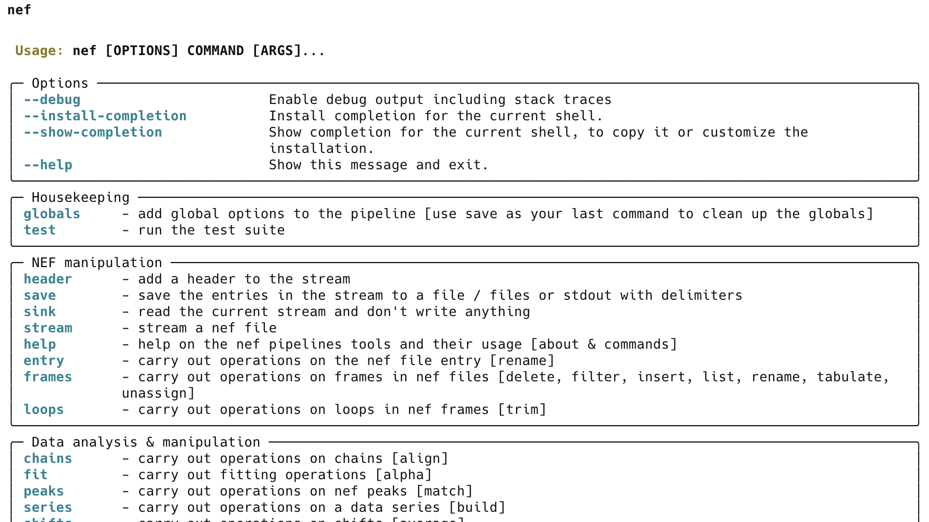
Start A Terminal
Mac users should start the terminal which is in the Utilities folder in Applications. It can be started by typing ⌘ spacebar and typing terminal
Unix users type Ctrl+Alt+T
Windows users open the start menu and type powershell in Search and open the Powershell app
Referencing and getting a copy of NEF-Pipelines
NEF-Pipelines is a program being written by Gary Thompson (University of Kent), a member of the CCPN Working group. It is still unpublished but you can reference it as Thompson, G. (2024). NEF-Pipelines (Version 0.1.117) doi: 10.5281/zenodo.11127005.
How to install the software is described in an appendix at the end of this document
Navigating NEF-Pipelines
To see if NEF-Pipelines is installed type nef on the command line you should get something like:
This output shows the available commands in NEF-Pipelines which either provide commands to deal with nef components chains, entry, frames etc. or commands to import and export nef data such as nmrpipe nmrview mars pales etc.

Slide 5
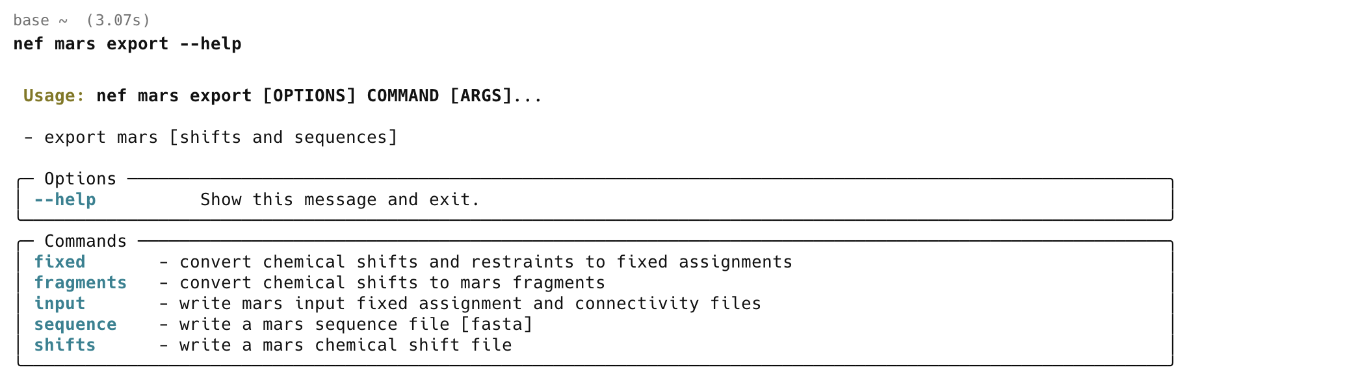
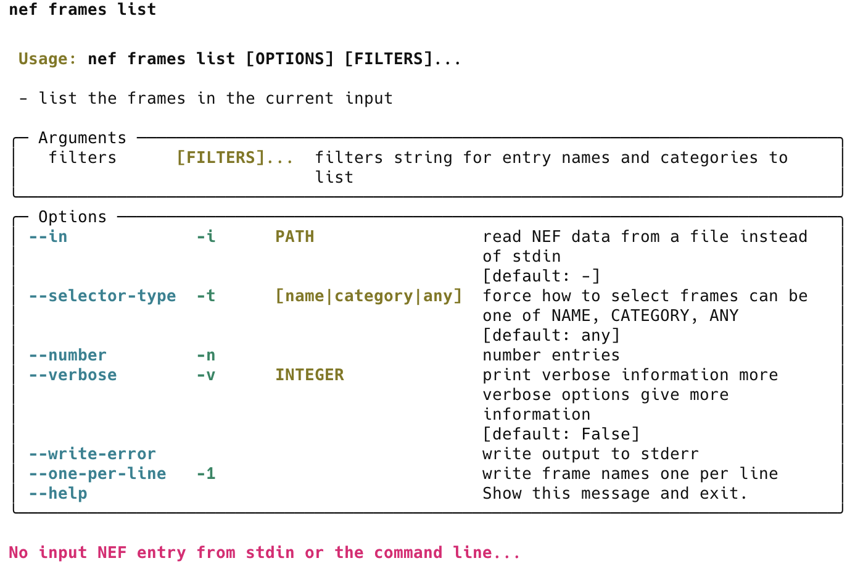
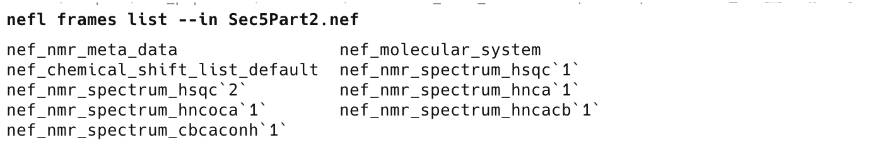
Generally, commands will show an error and this help screen or a more specific one if they don’t understand your input.
Tools may have sub-commands
Most tools have sub commands, for example the mars command has an export sub command which then has the further sub commands sequence, shifts and input. So, for example, typing nef mars export or
nef mars export --help shows:
Lets use our first Nef-Pipelines tool nef frame list if you type nef frames list on its own you will get
This is because it requires an input NEF file. Let's give it the Sec5BPart2.nef file we just exported. For now to do this we use the option –in [though nef frames list specifically also allows it as an argument as well]:

Slide 6
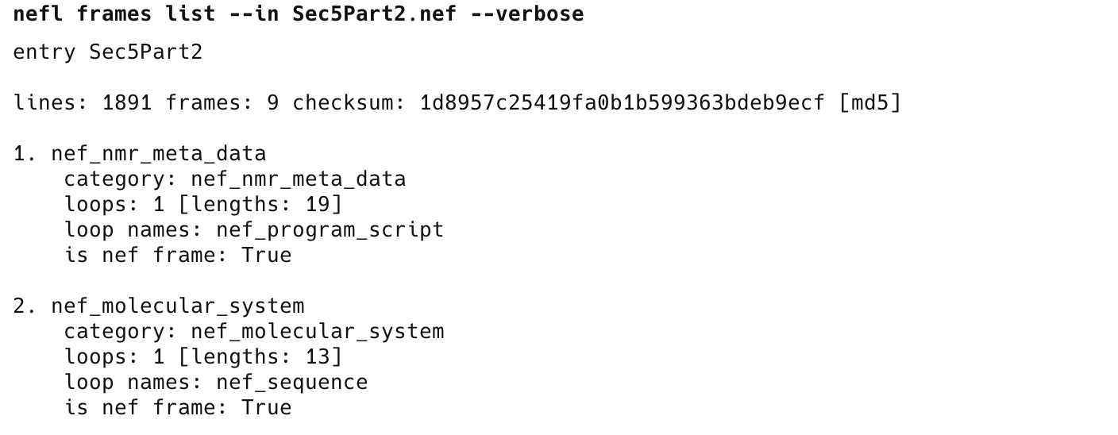
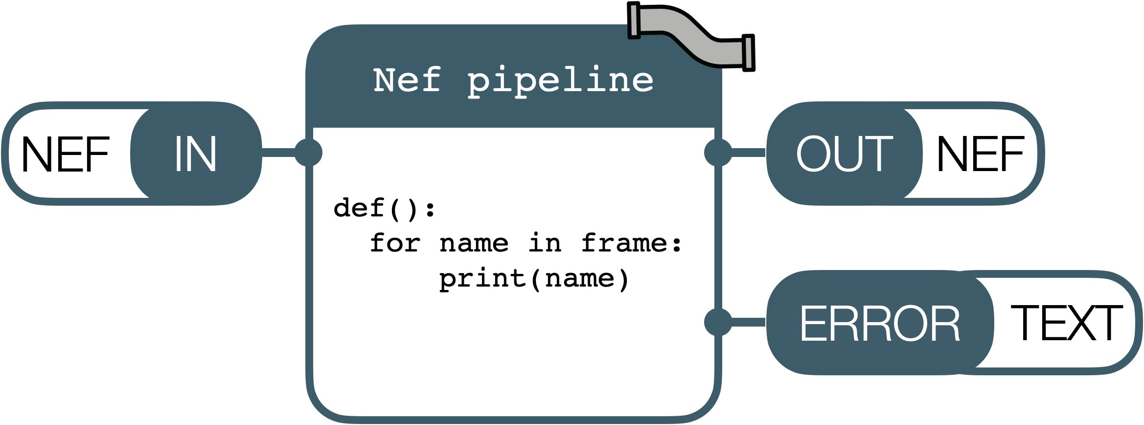
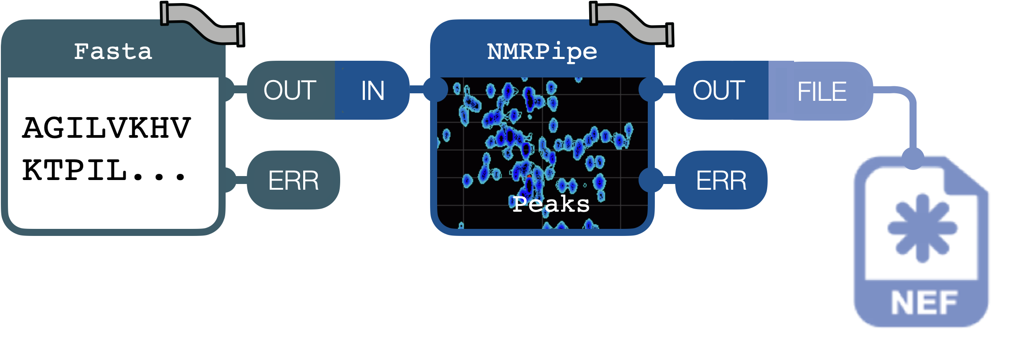
A we can see this contains a number of frames for spectra, some meta data nef_nmr_meta_data and a protein sequence nef_molecular_system; the name of the entry is Sec5Part2.
We can also use command line options to get more information (in this case –-verbose; which can be used more than once to get more information)
…
Using pipelines
We can also use command line options to get more information
As expected from the name of the program, pipelines are an important part of the program that we haven’t really investigated so far. So what’s a pipeline and how do we use them.
Each NEF-Pipeline command is an individual program with an input <IN> and two outputs <OUT> and <ERROR>; note <IN> and <OUT> read and write NEF text.
As you can see this gives you considerably more detail (which is written to the error output and so allows us to put this in a pipeline, see below…)
However, the real power comes from combining NEF-Pipelines commands together to build and modify a the text NEF ‘file’ as it is passed through the pipeline and then output to the screen or a file.
In this case sequence is read from a FASTA file and assigned peaks are read from NMRPipe and all the data are written as a NEF file on disc

Slide 7
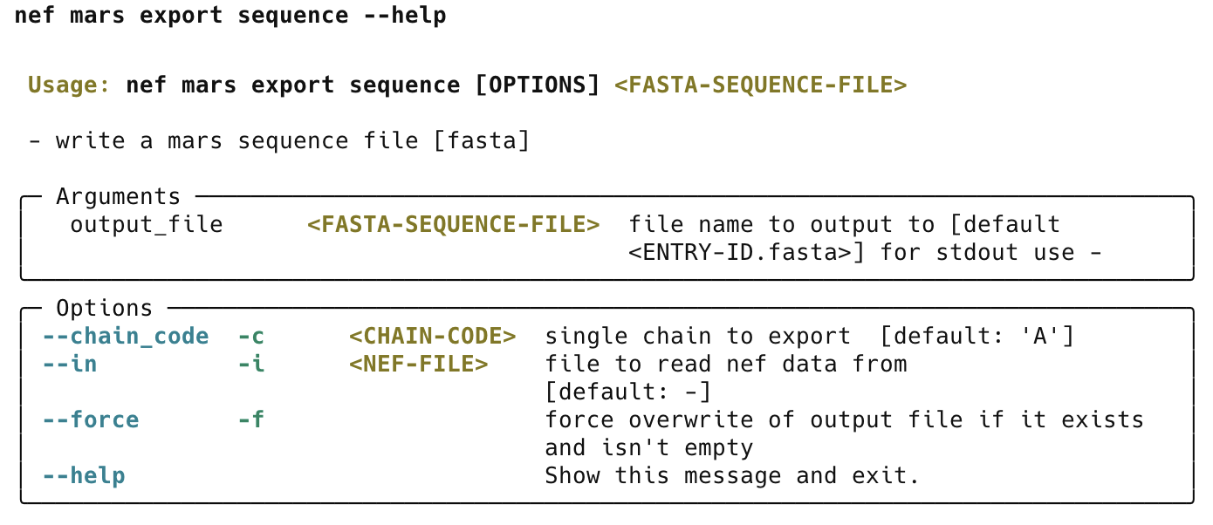
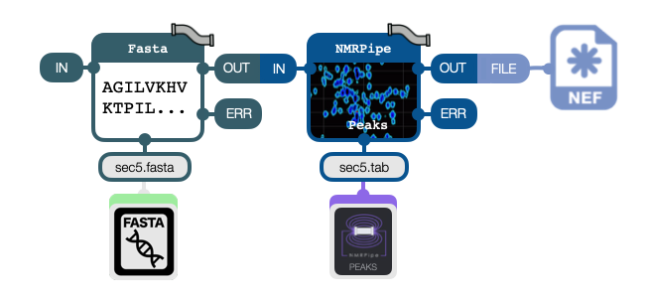
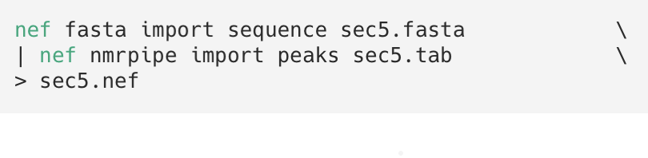
Typing nef mars export sequence or
nef mars export sequence --help shows
This shows input arguments to feed the command with data and options that maybe used to change how the command works. For example in this case MARS only works with a single molecular chain and we can use –c or --chain to select which chain to export from a NEF file if there is more than one. We won’t use arguments or options today but they are an important part of NEF-pipelines.
Commands may be combined using the pipe symbol
Multiple commands can be combined using the pipe symbol: | under Windows, Linux and OSX. This feeds the output of one command to the next command after the pipe symbol. The > character can be used to write to a file. Below is shown symbolically a pipeline that reads a FASTA file produces a stream which contains a NEF file that is fed to the nmrpipe command that adds nmrpipe peaks to the stream and then writes out to a NEF file containing both sets of data. This is followed by the command line you would use to run these commands.
Note: you don’t need to put \s at the ends of the lines if you want to write the complete command on one line, but, if you do there must be no space after them

Slide 8
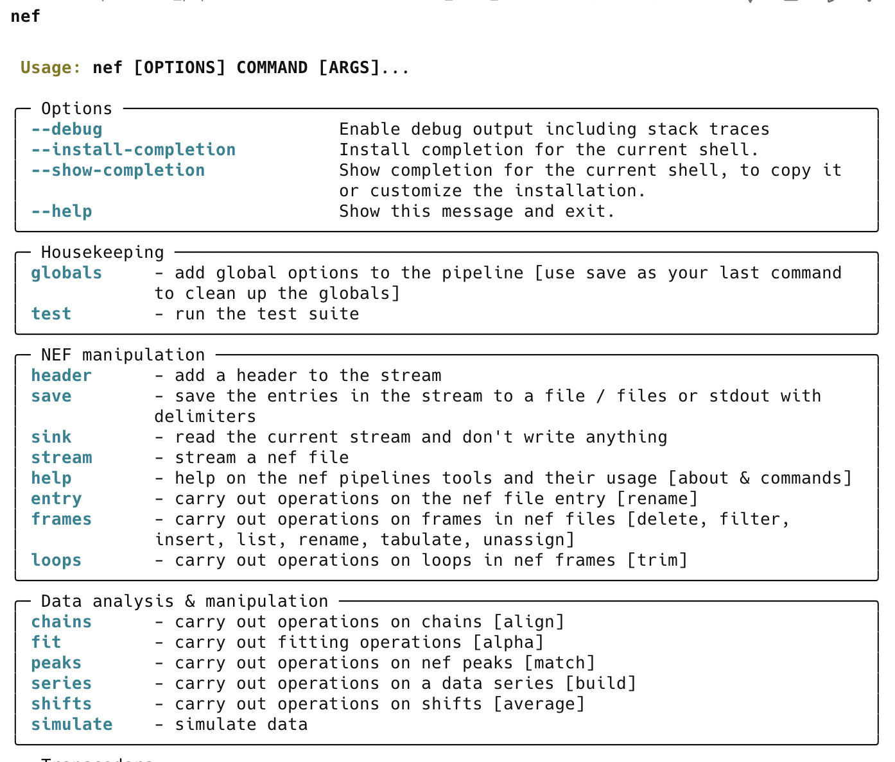
type nef to get
Installation
Installing NEF-Pipelines
NEF-Pipelines may be installed directly from the NEF-Pipelines github repo https://github.com/varioustoxins/NEF-Pipelines The best way to do this is using the UV tool using the script on the github site…
curl -sL https://raw.githubusercontent.com/varioustoxins/NEF-Pipelines/refs/heads/master/install_scripts/install.sh | sh
[note this should all be on one line…]
or you can use a script provided with CCPN Analysis. Just type
install_nef_pipelines, this will produce a lot of text output. Once NEF-Pipelines has installed you can type nef to get the text below
…
This output [and more that isn’t shown; …] demonstrates that the program is working

Slide 9
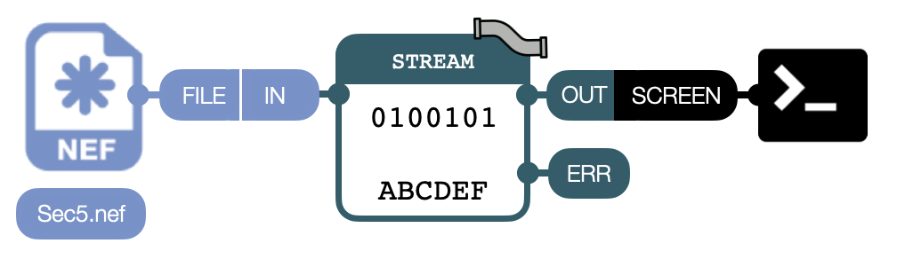
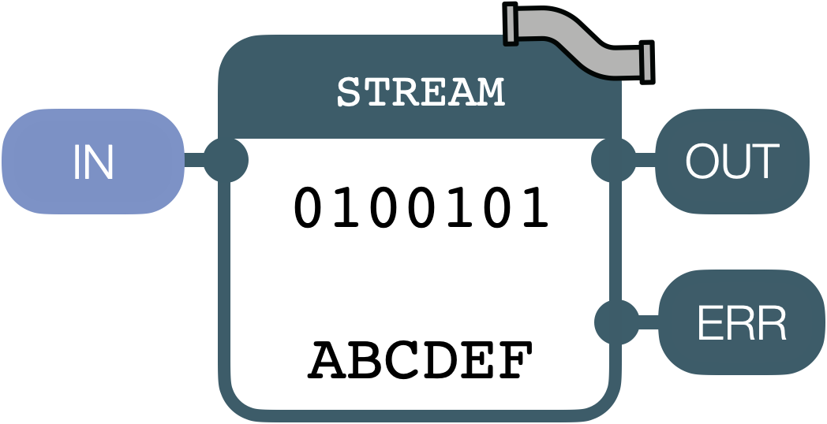
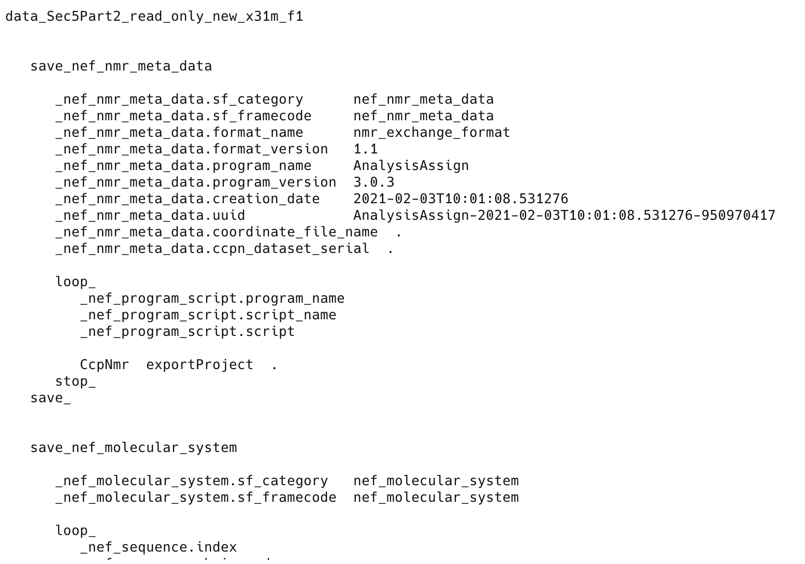
1
Streaming a NEF File to screen
NEF-Pipelines
First of all we are going to stream a NEF file sec5.nef to screen,
the diagram below show conceptually what we are doing
Self-explanatory image
Note how much data this NEF file contains, its is the information about a complete NMR assignment project with peaks, shifts, a molecular system and other data its quite complex. NEF-Pipelines is designed to manage this complexity…
A NEF pipeline tool is represented by this symbol
It has a name an input and an output.
We shall use these symbols throughout the
tutorial
1A
Streaming the file to screen To do this type the following in the terminal
Note that our sec5 data is stored in tests/test_data/sec5.nef . You will need to correct the path to your sec5.nef file from the tutorial data. You will see the file contents go by.
…
…

Slide 10
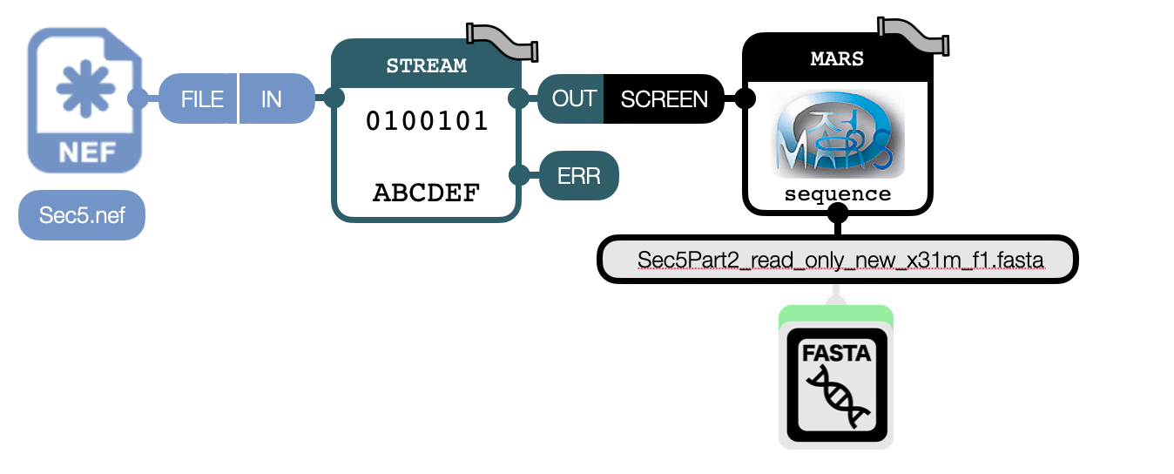
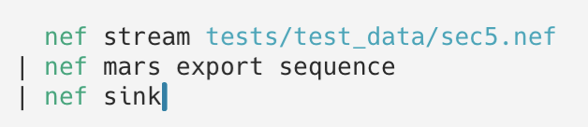
1
Molecular Sequence to Fasta
NEF-Pipelines
Now we will not connect the stream to the screen but to a tool that will
write out a sequence for MARS. Conceptually we have
Self-explanatory image
1B
Outputting the stream to a MARS sequence file To do this type the following in the terminal
Note if will see text like the following, this indicates that the output .fasta file already exists and you need to add the force flag [nef mars export sequence --force]
If you type ls in your terminal you will now find a new file called Sec5Part2_read_only_new_x31m_f1.fasta this is a rather ugly name that comes from the name of the contents of the NEF file, we will make it a nicer name a bit later. If you open the file Sec5Part2_read_only_new_x31m_f1.fasta with a text editor you will find it contains the text
This is the sequence of the protein sec5 in the format used by MARS (fasta) plus some data to allow easy reimportation. This is quite different to how the sequence is stored in the NEF file. If there was more than one chain in the NEF file NEF-Pipelines would ask you select which chain to use as MARS can only run on a single chain…
Note how you no longer see lots of NEF text written to screen. The pipeline normally outputs the complete NEF stream so you can see it but the extra nef sink command at the end of the pipeline absorbs the NEF data to keep your screen clean.
You can specify the file to write the fasta sequence to as an argument to the command e.g. nef mars export sequence my_file.fasta

Slide 11
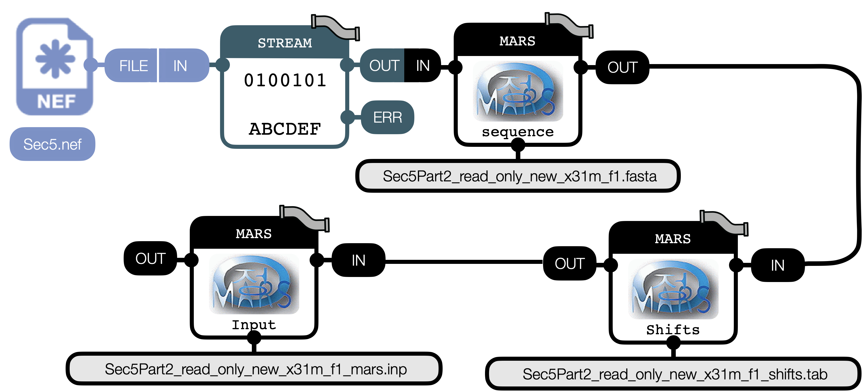
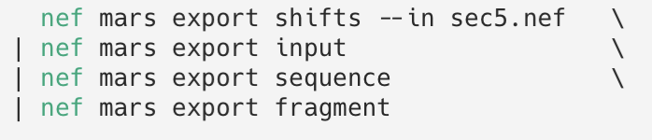
1
Writing the rest of the files
NEF-Pipelines
MARS takes several files which it needs to run we will now add the extra tools
that write these files (shifts and most of a project input file)
1C
Outputting the stream to the rest of the MARS files To do this, type the following in the terminal. Please write all the text on one line (here it is spread out over more than one line to make it fit on the page!). Note that you can use the up and down arrows to show previous commands you ran which can be edited and rerun by typing return again
If you type ls Sec5* in your terminal you will now find you have quite a lot more files
These are the rest of the files you need to run MARS: a sequence file, a list of chemical shifts and an input file. If you investigate the input tool you will find options to write in the input file if it is data for a folded protein and if it is deuterated protein.
The files ..._ass.tab and …_pred.tab are for telling MARS about residue types and strings of residues that have already been combined together by previous assignments. These are currently empty as the MARS tool is not sophisticated enough to write them yet, you would have to write them yourself!
Please also note that you would need to obtain a psipred formatted prediction of the protein's secondary structure to run MARS, though we may be able to derive this from alphafold more quickly in the future….
Psipred can be found at http://bioinf.cs.ucl.ac.uk/psipred/.

Slide 12
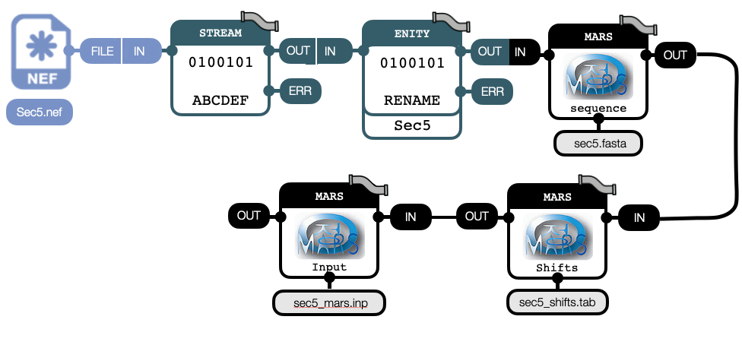
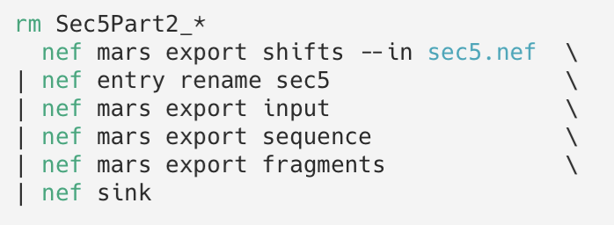
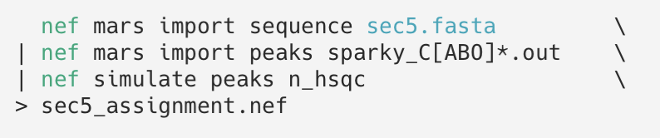
1
Making it less ugly
NEF-Pipelines
The names of the files the MARS tools output are taken from the name of
NEF file Entry. If we change this at the start of the stream it will give better
file names but won’t affect the original file on disk (unless you write it first)
Self-explanatory image
1D
Renaming the NEF file Entry If we rename the entry inside the NEF file (the structure that contains all the data) we will change the names of all the output files when they are exported as their names are based on the entry name…
If you type ls sec5* in your terminal you will now find you have files with much nicer names
To import you data back into NEF after assignment with MARS [runmars sec5.inp] you can do
…

Slide 13
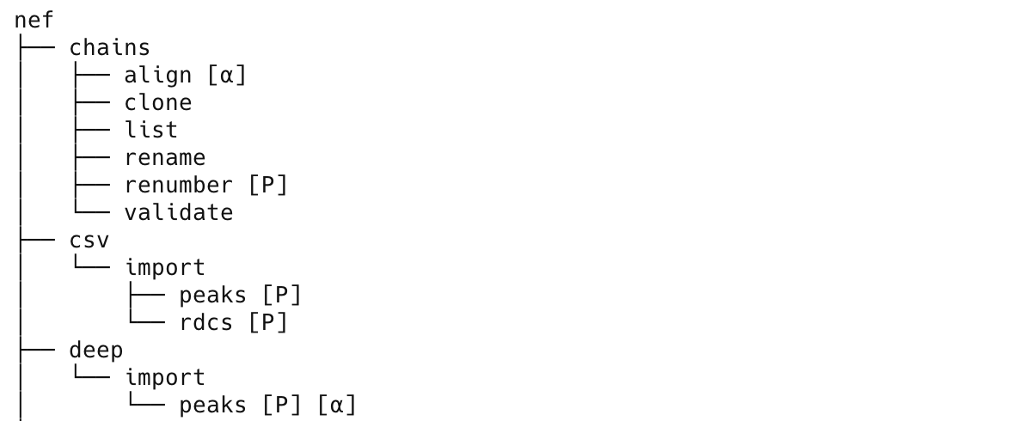
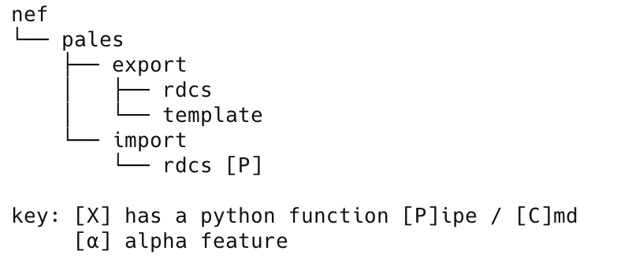
1
Where next
NEF-Pipelines
There is a lot more you can do with NEF-Pipelines including:
manipulating chains and nef file contents [frames and loops].
de-assigning specific data
importing data from the bmrb
aligning imported data with the molecular system
calculating shifts of pdb structures and alphafold structures with the online shiftx2 server
Read in and simulate RDCs with PALEs
You can align and trim PDB and mmcif files to you molecular system to just name some highlights off the cuff
To get an outline of the available commands: nef help command
…
and adding a search term filters the tree nef help commands pales
Finally
NEF-Pipelines can be used as a python or Julia library
NEF-Pipelines is under active development, plans include better NMRPipe support, Excel IO, basic relaxation data fitting [in beta], support for NEF relaxation data, etc…
If you can’t see what you need contact Gary g.s.thompson@kent or post a request on the forum and we also support code contributions!
We plan to publish more workflows on the NEF-Pipelines website https://github.com/varioustoxins/NEF-Pipelines

Slide 14
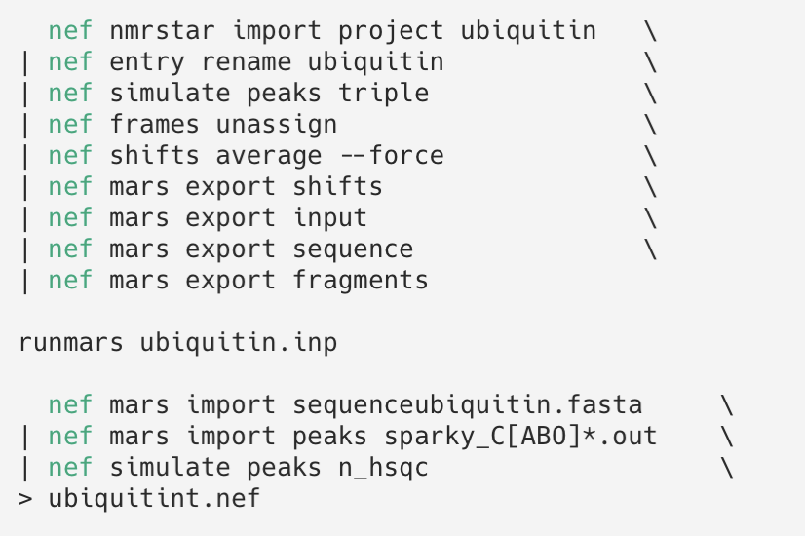
1
An example for ubiquitin
NEF-Pipelines
This example uses NEF-Pipelines automated download with a complete example using ubiquitin
When building up long sophisticated commands like this remember
build the command in parts and test as you go
if what you need is missing you can add other unix commands and scripts, for example in python, to the workflow

